Slide 1

Optical and Eye Channeling Management System for Eye Care (Pvt) Ltd
Group ID -

Slide 2

Agenda
Introduction
Company Background
Problem statement
Solutions
Benefits of the system
System overview
System Functions
Tools and technology
Work distribution
Gant chart

Slide 3

Introduction

Slide 4

introduction
Eye care is a company that provide services to spectacle users and eye patients. This company wats to uplift with their features and services with latest technology and wanted to market them self over competitors. As a example this company provide channeling facilities for eye patients and also help to manage their patient details with up-to-date reports and help to manage their medical history. It is very easy to use when working with old patients due the lack of knowledge and unconscious situations. Also this company provides leading eye checking methods and much more when you are buying new spectacles. As other vision care centers, this company also have a large amount of designs and it helps to select a most suitable designs for their customers. This company is based on supplying high quality spectacles.

Slide 5
Company background
Eye care is a company that provide services to spectacle users and eye patients.
This company wats to uplift with their features and services with latest technology and wanted to market them self over competitors.
As a example this company provide channeling facilities for eye patients and also help to manage their patient details with up-to-date reports and help to manage their medical history.
It is very easy to use when working with old patients due the lack of knowledge and unconscious situations.
Also this company provides leading eye checking methods and much more when you are buying new spectacles.
As other vision care centers, this company also have a large amount of designs and it helps to select a most suitable designs for their customers.
This company is based on supplying high quality spectacles.

Slide 6

Problem statement
Both customer and patient must visit the shop to fulfill their requirements and also the customers must follow a manual way when placing an order or an appointment.
Facing difficulties when storing data manually and it cause human errors.
When a customer need to know more about spectacles specification, receptionist or a staff member should describe everything manually this is a much waste of time.
Difficulty in updating records in the manual way.
Hard to get customer feedbacks due to the paperwork.

Slide 7
Solutions
The company requirements can be fulfilled by developing a web application. Where the customers can connect the company through it.
Providing user friendly interfaces to the patients and customers. Where they can understand about the goods without the help of the owner.
Providing a database to store all the details of designs, patients, customers and stocks which help to owner to manage the details easily without time wasting.
Providing a facility to sellers to write a description about spectacles and services including prices. So that, the staff members doesn’t need to describe about the items for customers individually.
Providing the user profiles and patients profile which can access by the employees (staff and nurses). So that, they see their previous transactions and previous medical records.
Providing a confidential interface with a function to handle payment details of the business, therefore the owner can calculate profits, calculate salaries of the employees, manage payment methods and manage transaction details easily.

Slide 8






Benefits of the system
User friendly-both patients and customers can use the system easily.
More manageable-because it is web-based system any one can access from any where to the system. (with authorization and authentication)
High level security-all customer and patient details are encrypted.
Generate monthly, daily reports-easy to have a look on various things with the profit and loss of the company.
More user friendly with user guidelines
Easy to understand interfaces guide any one to operate the system easily without prior knowledge.

Slide 9
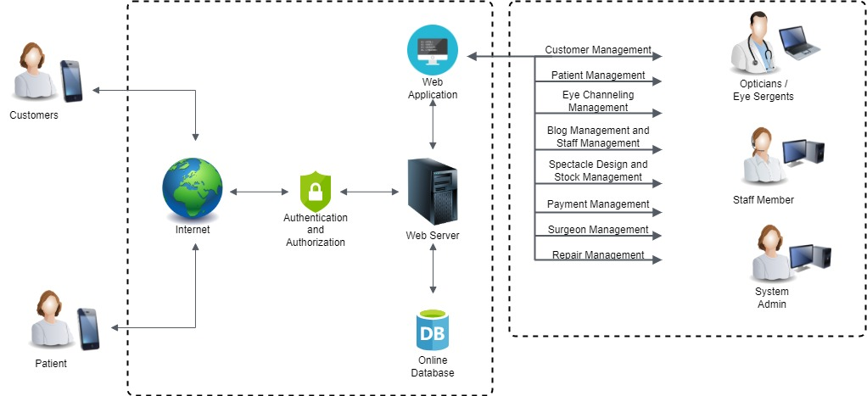
System Overview

Slide 10

System Functions

Slide 11

Customer Management
Collect the customers personal information
Register them in the eye care system.
Create a customer profile.
Take orders from customers.
Acquire information about customer’s payment method.
Generate report.

Slide 12

Patient Management
Collect patient registration information.
Acquire the patient's medical records.
Manage available patient.
Manage patient schedule.
Generate reports.

Slide 13

Eye Channeling Management
Create appointments.
Manage appointments.
Update appointments details.
Generate report.

Slide 14

Blog management and staff management
Maintain eyecare articles.
Create staff accounts.
Generate reports.

Slide 15
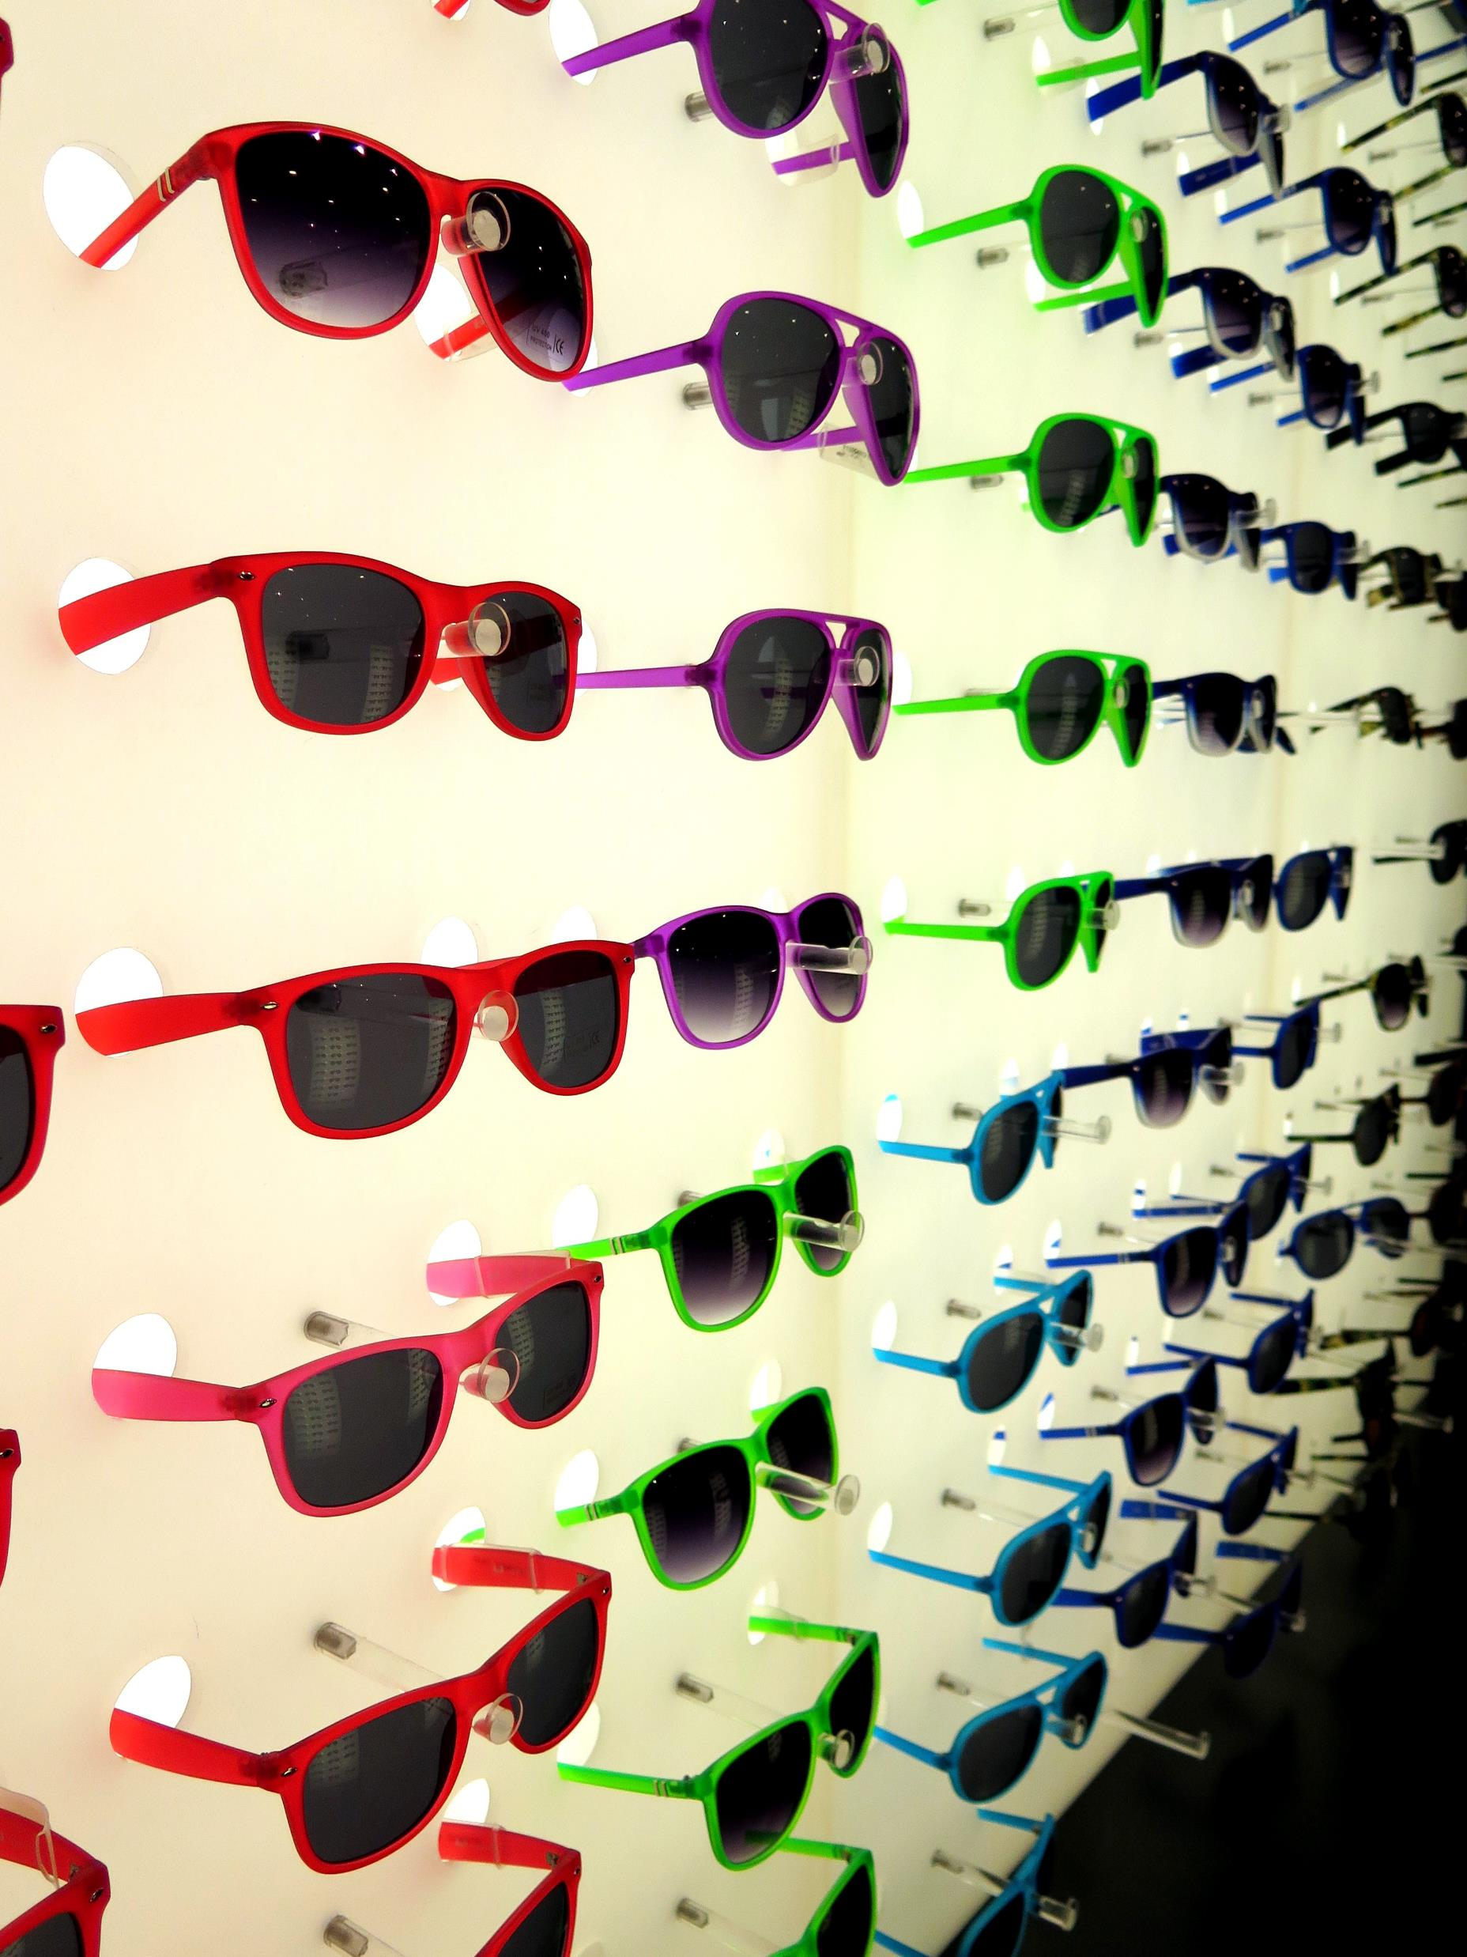
Spectacle design and stock management
Add new spectacles design.
Maintain available spectacles.
Design spectacles for customer requirements.
Completion notice.
Generate stock reports.

Slide 16
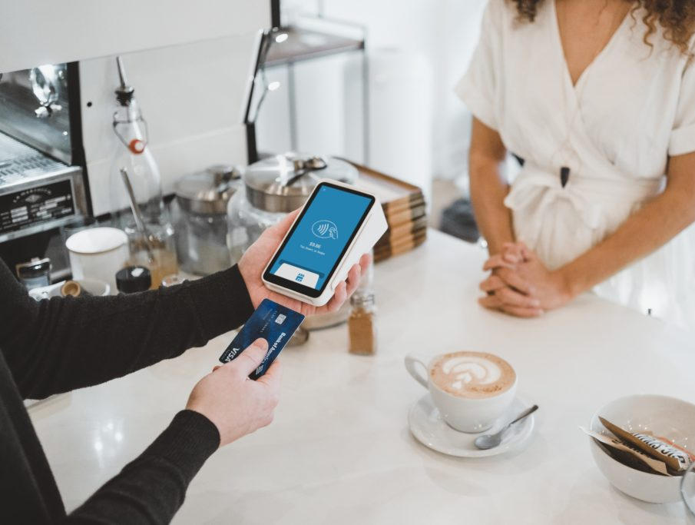
Payment management
Manage all payments.
Record all transactions.
Return payment for appointment cancelation.
Generate reports.

Slide 17

Surgeon management
Create surgeon profiles.
Surgeon can verify available patients.
Provide a report.
This Photo by Unknown Author is licensed under CC BY

Slide 18

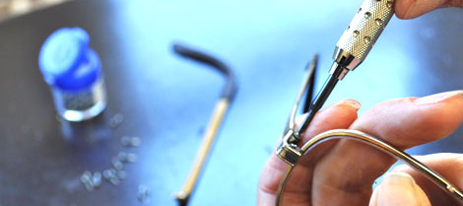
Repair management
Add repair
View repair status
Feedback for repairments.
Create monthly reports for repairments.

Slide 19
Tools and technologies
To develop this web application we use MERN stack and REST API.
Mongo DB as the Database
Express JS used as the Back-END Configurations
React JS used as the Front-End Configurations
Node and NPM used as the run time environments and testing.
REST API used to connect Back end to the Front end with the security and more Things.

Slide 20
Work distribution
Name and IT number | Work distribution
Name – IT number - | Customer Management User interface development Back-end development Implementing the related create, update, retrieve and delete functions. Creating the database Generating the report
Name – IT Number - | Patient Management User interface development Back-end development Implementing the related create, update, retrieve and delete functions. Creating the database Generating the report
Name – IT Number – | Eye Channeling Management User interface development Back-end development Implementing the related create, update, retrieve and delete functions. Creating the database Generating the report

Slide 21
Work distribution
Name and IT number | Work distribution
Name – IT Number – | Blog management and staff management User interface development Back-end development Implementing the related create, update, retrieve and delete functions. Creating the database Generating the report
Name – IT Number – | Spectacle design and stock management User interface development Back-end development Implementing the related create, update, retrieve and delete functions. Creating the database Generating the report
Name – IT Number – | Payment management User interface development Back-end development Implementing the related create, update, retrieve and delete functions. Creating the database Generating the report

Slide 22
Work distribution
Name and IT number | Work distribution
Name – IT Number – | Surgeon management User interface development Back-end development Implementing the related create, update, retrieve and delete functions. Creating the database Generating the report
Name – IT Number – | Repair management User interface development Back-end development Implementing the related create, update, retrieve and delete functions. Creating the database Generating the report

Slide 23
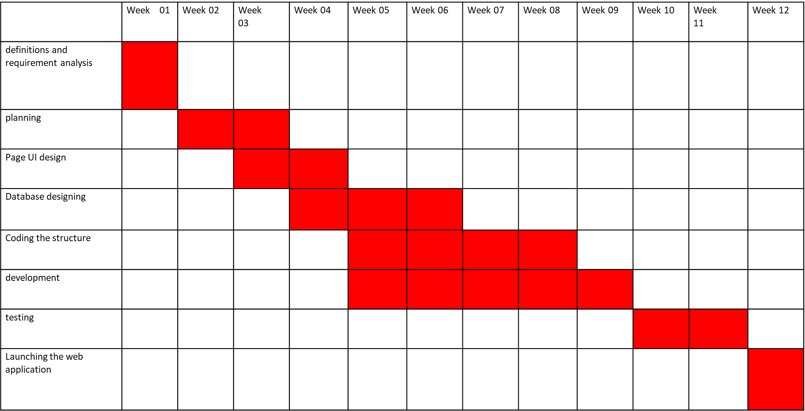
Gannet Chart

Slide 24

Thank you..!

